Slide 1


Slide 2
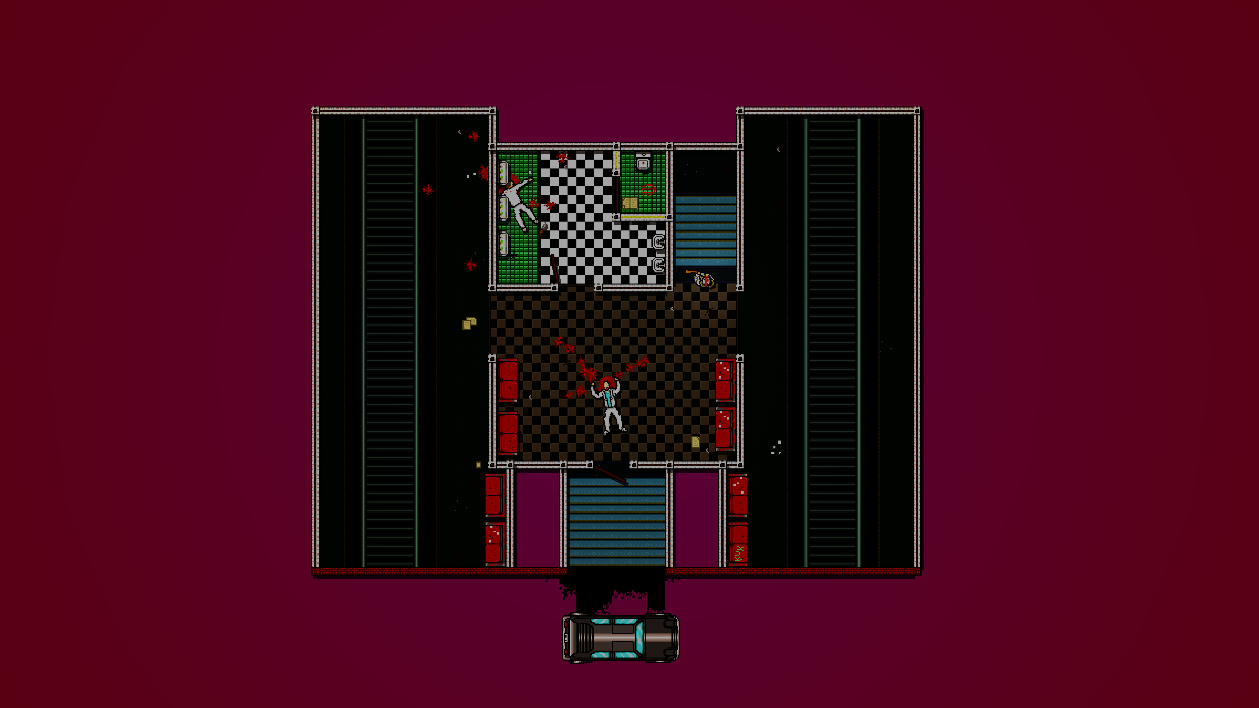

Introduction
From GameMaker to GameBaker
Porting Hotline Miami
Frans Kasper, Control Conference 2015

Slide 3
Introduction
Introduction
Porting at Abstraction Games
SilverWare
Hotline Miami Ports
Frans Kasper, Control Conference 2015

Slide 4
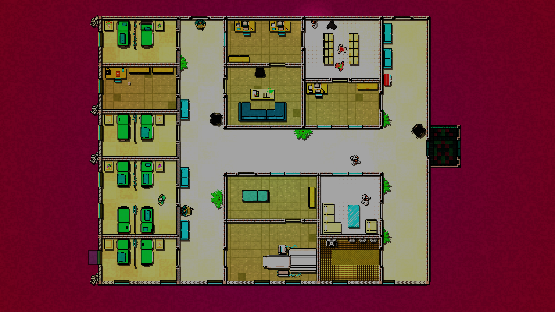


Slide 5

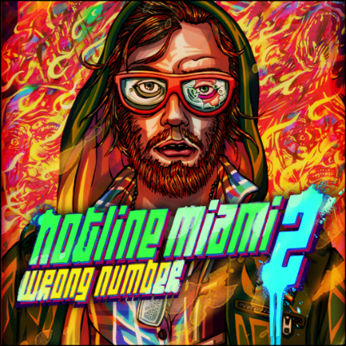
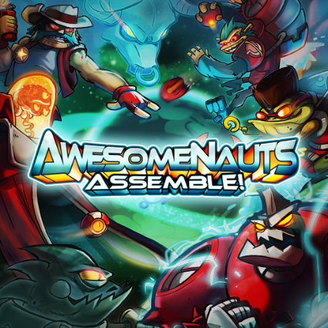
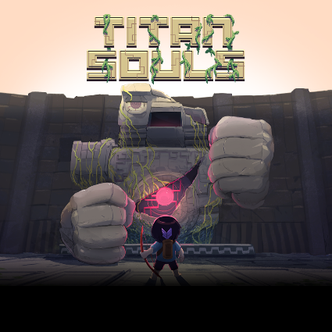

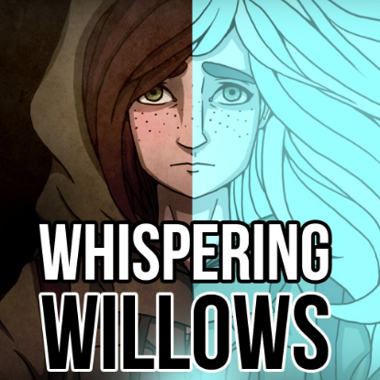





Slide 6












Slide 7


Slide 8
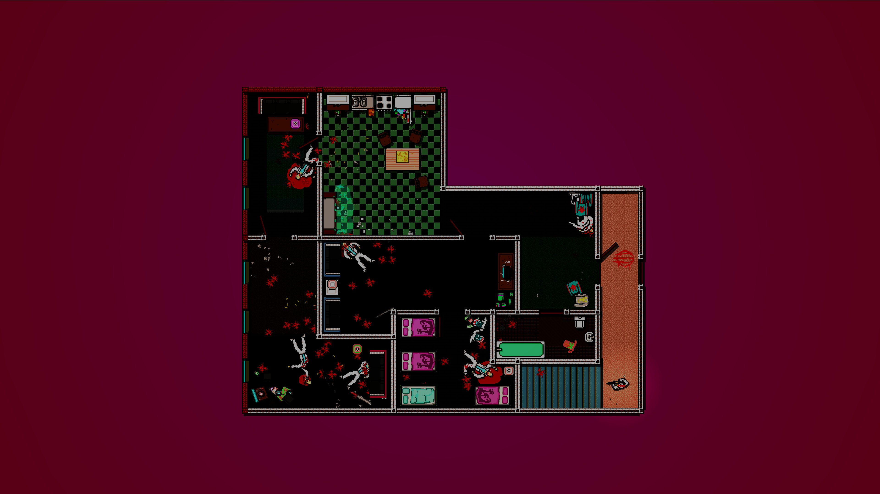
Porting at Abstraction
Introduction
Porting at Abstraction Games
SilverWare
Hotline Miami Ports
Frans Kasper, Control Conference 2015

Slide 9
Porting at Abstraction
Remakes
Use original code mostly as reference
May re-use assets
Frans Kasper, Control Conference 2015

Slide 10
Porting at Abstraction
Ports
Use original code directly
Use existing assets and toolchains
May need language-to-language conversions
Frans Kasper, Control Conference 2015

Slide 11
Porting at Abstraction
Emulations
Use original binaries and content as-is
Frans Kasper, Control Conference 2015

Slide 12
Porting at Abstraction
Normalization
Convert to cross-platform framework
Hide platform specifics from game/engine
Improve shared technology constantly
Can do most development without devkits
Frans Kasper, Control Conference 2015

Slide 13
Porting at Abstraction
‘Black Box’ ports
Use closed-source and unsupported technology
Require reverse engineering
May require language-to-language conversions
Frans Kasper, Control Conference 2015

Slide 14
Porting at Abstraction
Adaptation
Tailoring Controls & UI
Platform-Specific Features
Quality Assurance & First Party Submissions
“Best on Vita”
Frans Kasper, Control Conference 2015

Slide 15
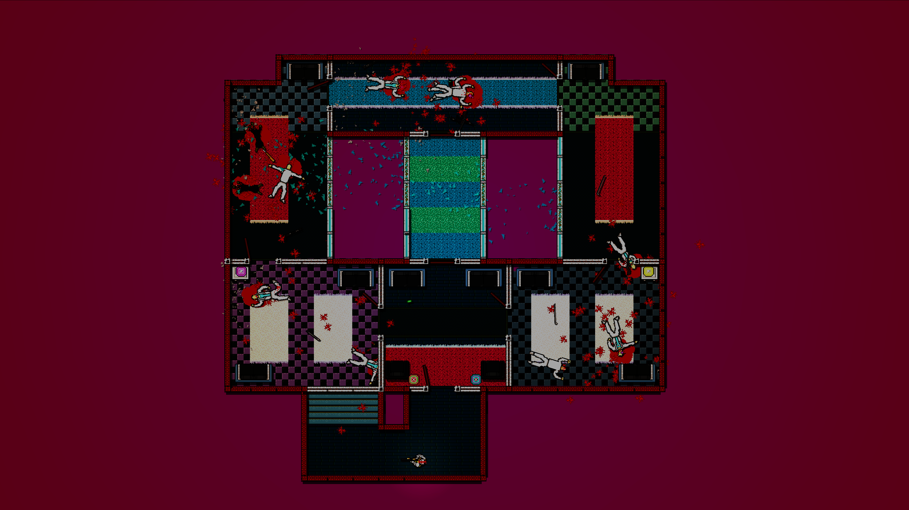
SilverWare
Introduction
Porting at Abstraction Games
SilverWare
Hotline Miami Ports
Frans Kasper, Control Conference 2015

Slide 16
SilverWare
Cross-Platform C++ Library for Porting
SDK for a ‘virtual platform’
Modeled after low-level libraries
Not a game engine
Not strictly low-level
Frans Kasper, Control Conference 2015
Notes:
Initially developed for Rogue Legacy in between HLM1 and HLM2.

Slide 17
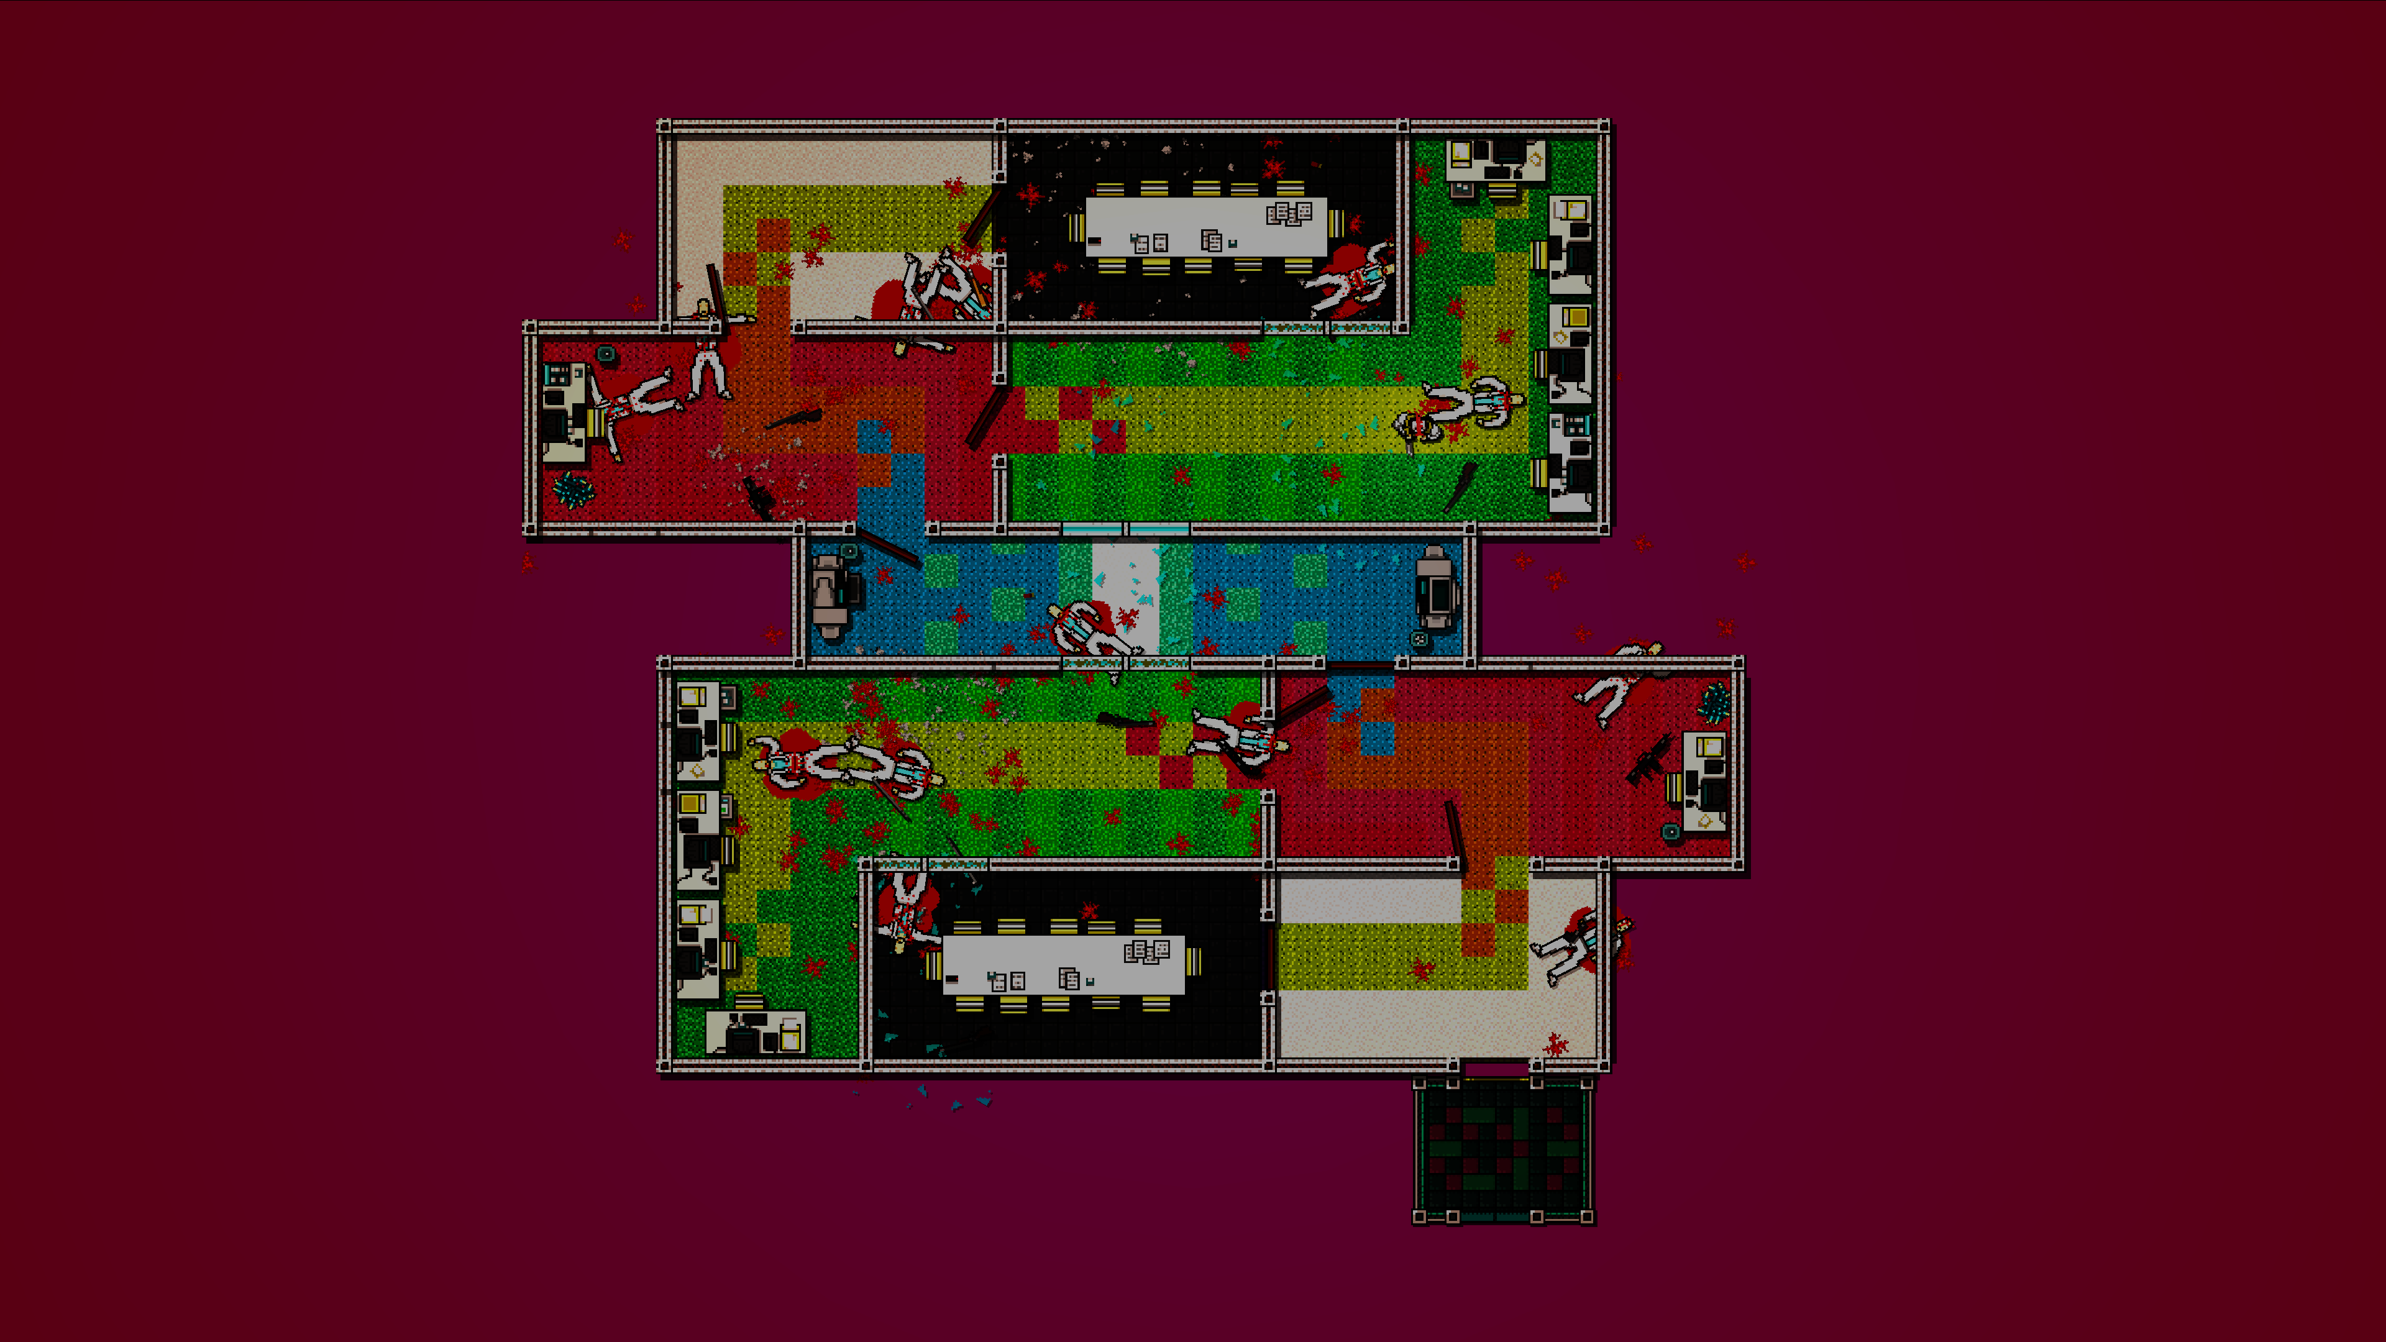
Hotline Miami
Introduction
Porting at Abstraction Games
SilverWare
Hotline Miami Ports
Frans Kasper, Control Conference 2015

Slide 18
Data Conversion
GameMaker Data
Fonts
Sounds
Sprites
Backgrounds (‘Tilesets’)
Objects (‘Classes’)
Rooms (‘Levels’)
Scripts (‘Functions’)
Encoded in single binary .GMK file.
Frans Kasper, Control Conference 2015

Slide 19
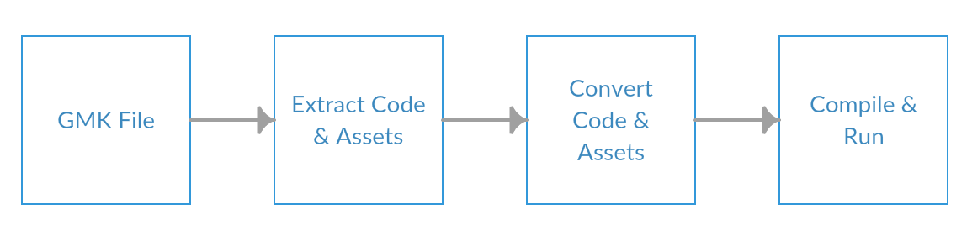
Hotline Miami
Frans Kasper, Control Conference 2015

Slide 20
Data Conversion
Data Conversion
Code Conversion
Architecture
Pros & Cons
Frans Kasper, Control Conference 2015

Slide 21
Data Conversion
ENIGMA
C# Tools
Export data to generic format
Resources as PNG, WAV, Bitmap Font, etc.
Other data as 1:1 memory-mapped tables.
Frans Kasper, Control Conference 2015

Slide 22
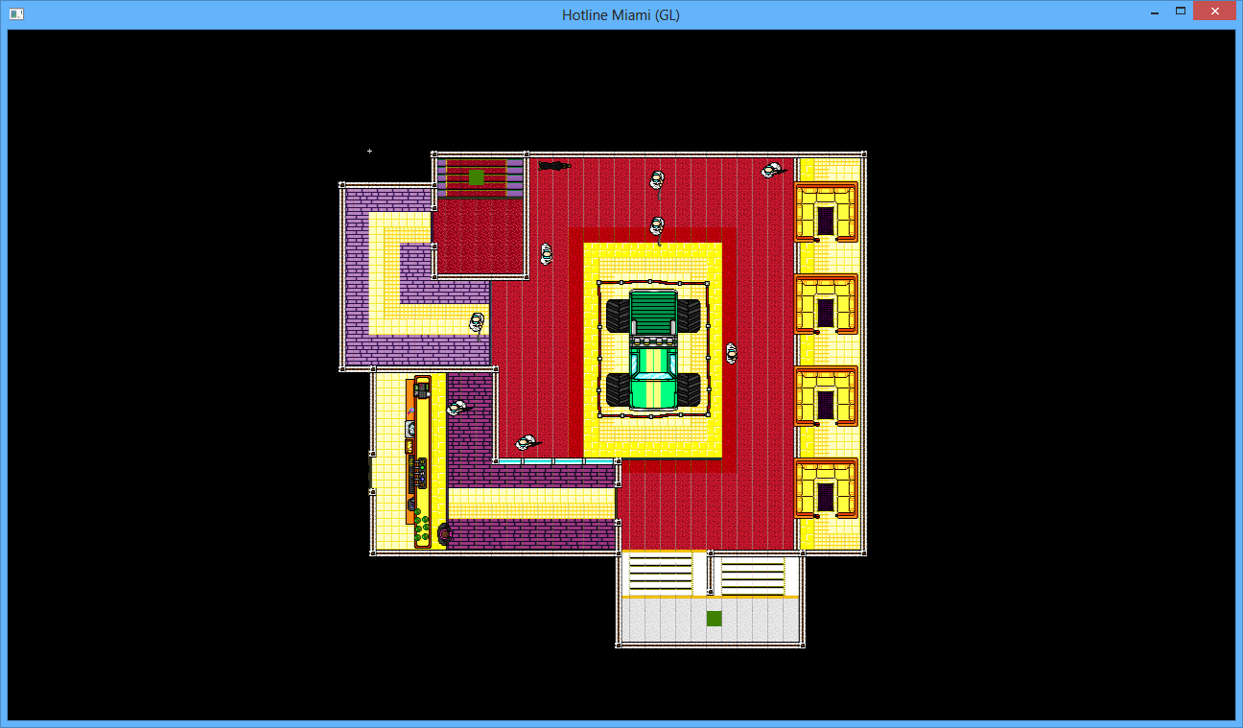
Data Conversion
Frans Kasper, Control Conference 2015

Slide 23
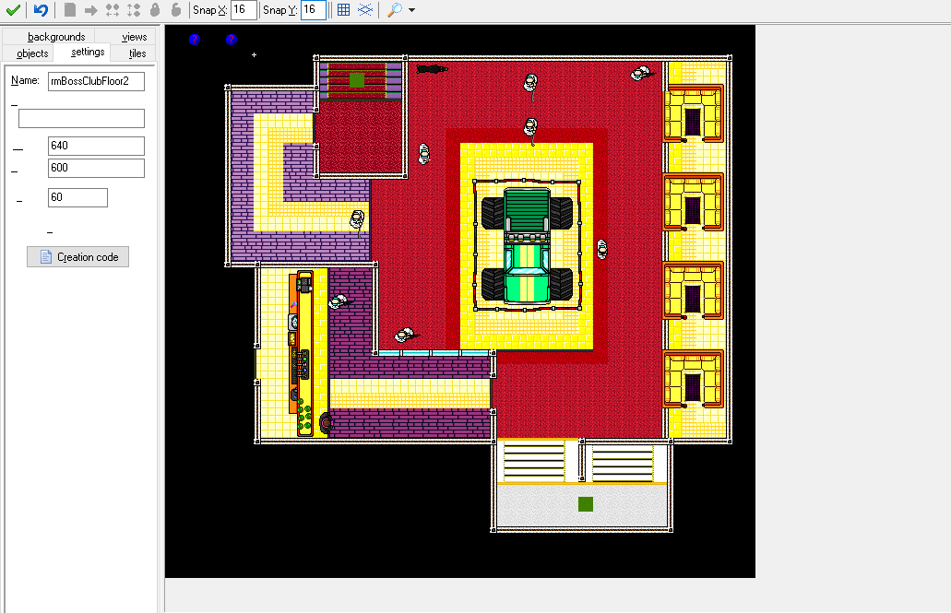
Data Conversion
Frans Kasper, Control Conference 2015

Slide 24
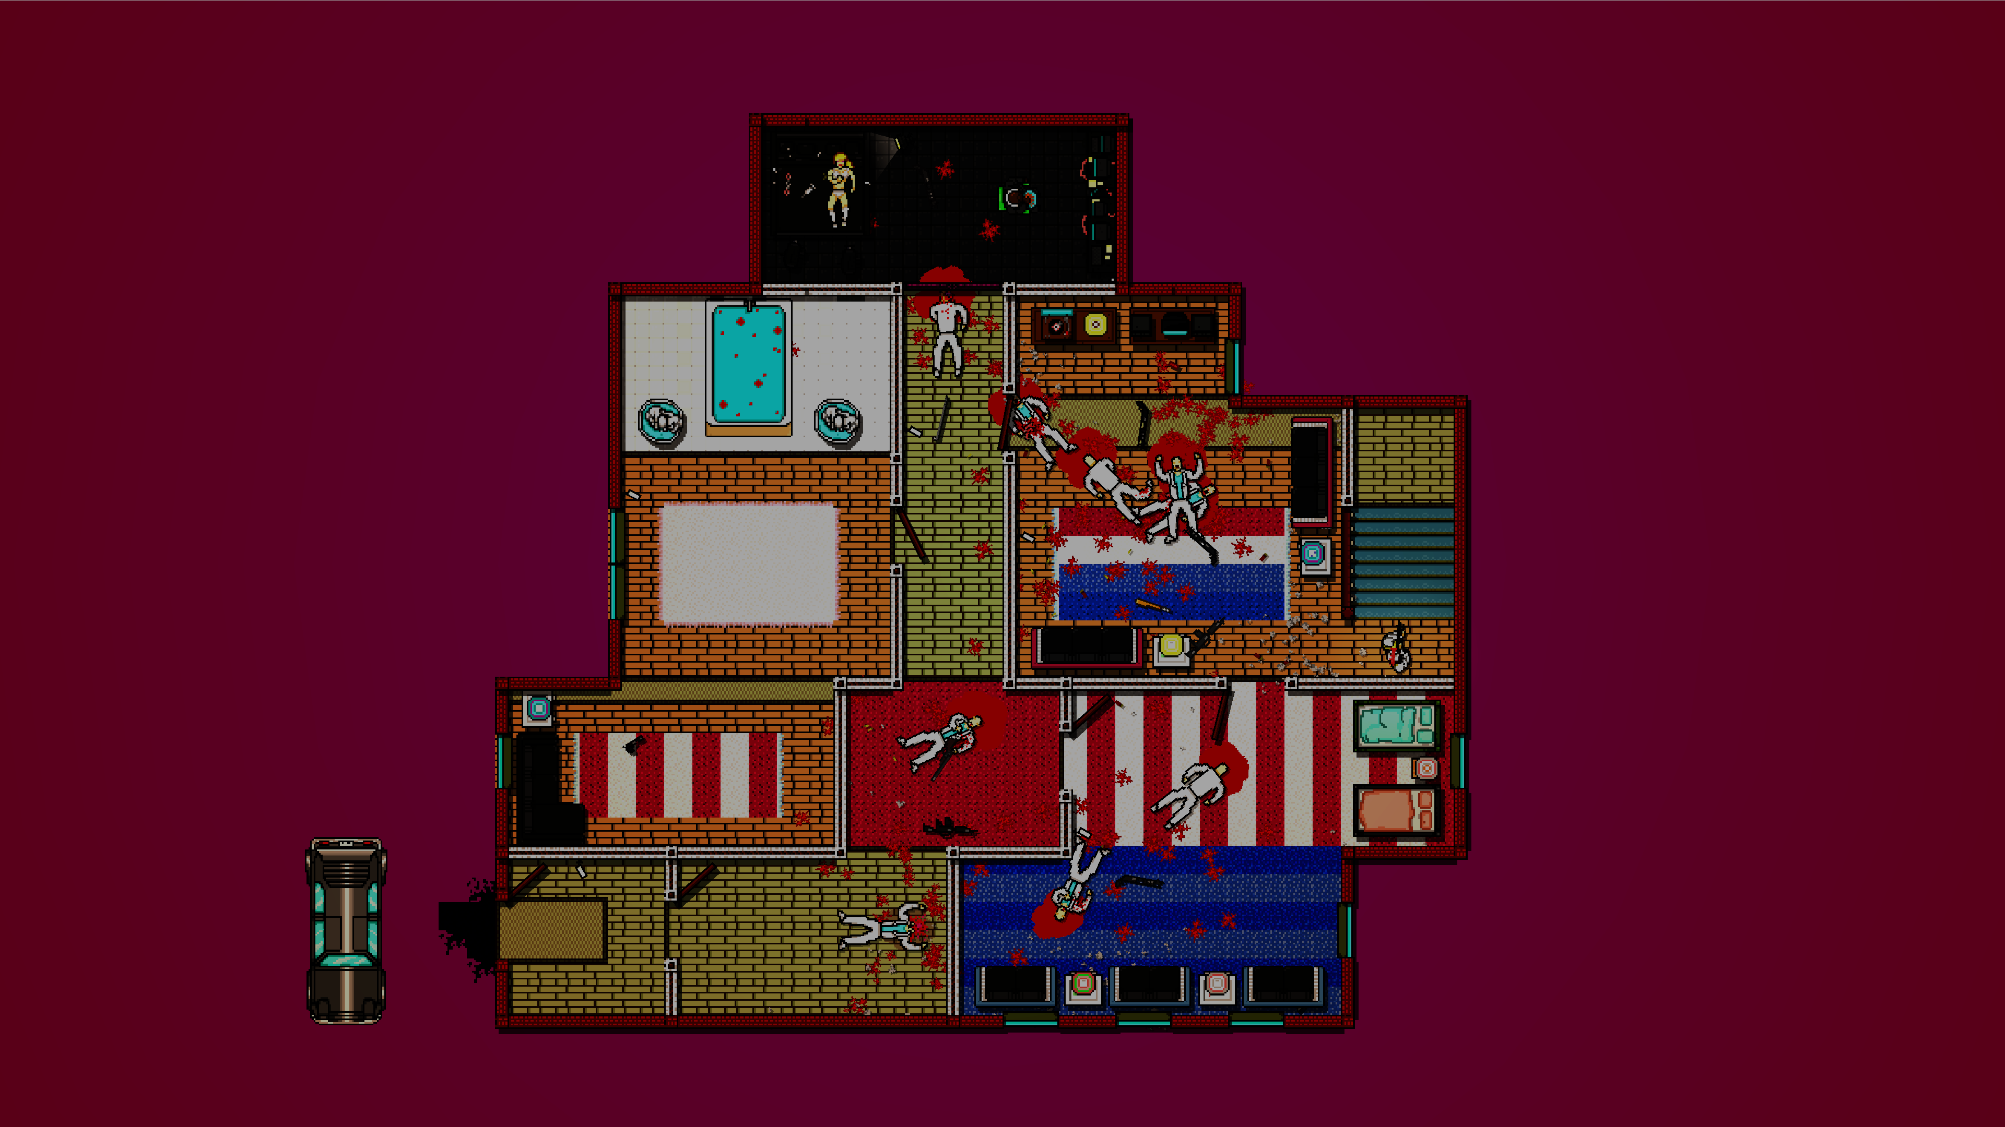
Code Conversion
Data Conversion
Code Conversion
Architecture
Pros & Cons
Frans Kasper, Control Conference 2015

Slide 25
Code Conversion - IRONY
IRONY.NET Language Implementation Kit
‘Development Kit for Implementing Languages’.
Write grammar directly in C#.
No specialized Scanner/Parser language.
Frans Kasper, Control Conference 2015

Slide 26
Code Conversion - IRONY
// IRONY.NET grammar definition example
switch_statement.Rule = "switch" + expression + Lbr + switch_sections_opt + Rbr;
switch_section.Rule = switch_labels + statement_list;
switch_sections_opt.Rule = MakeStarRule(switch_sections_opt, null, switch_section);
case_statement.Rule = "case" + expression + colon;
switch_label.Rule = case_statement | "default" + colon;
switch_labels.Rule = MakePlusRule(switch_labels, null, switch_label);
Frans Kasper, Control Conference 2015

Slide 27
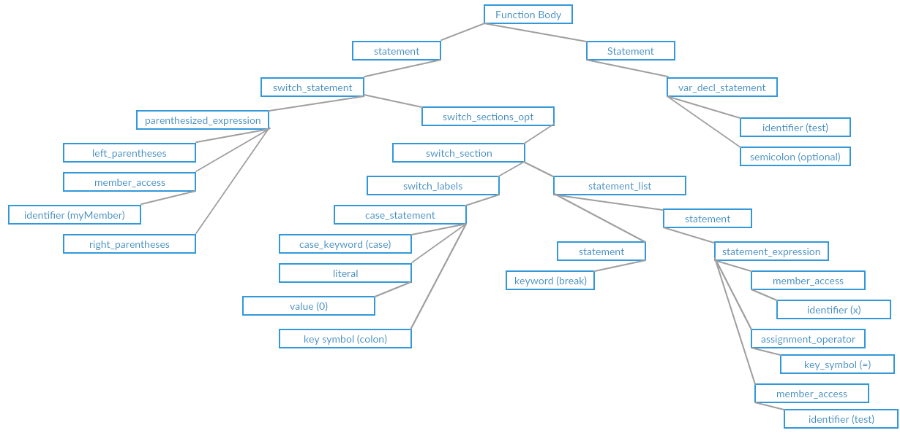
Code Conversion - IRONY
// Code Sample
var test;
switch ( myMember )
{
case 0:
x = test;
break;
}
Frans Kasper, Control Conference 2015

Slide 28
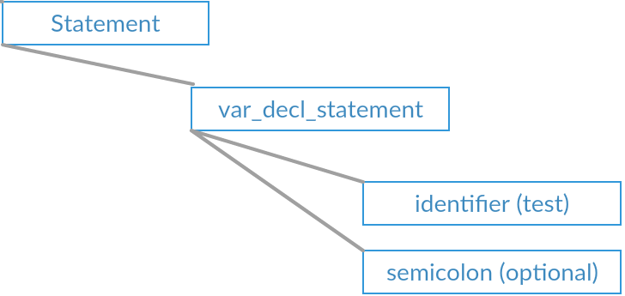
Code Conversion - IRONY
// Code Sample
var test;
switch ( myMember )
{
case 0:
x = test;
break;
}
Frans Kasper, Control Conference 2015

Slide 29
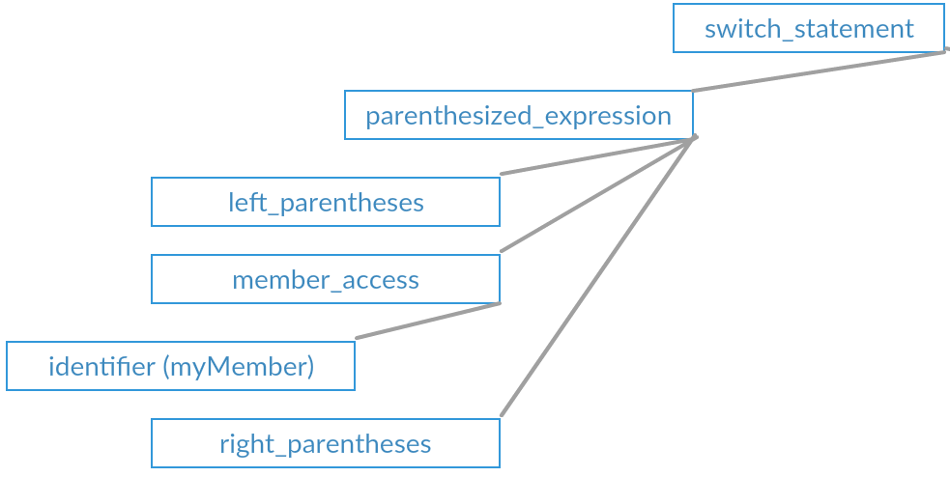
Code Conversion - IRONY
// Code Sample
var test;
switch ( myMember )
{
case 0:
x = test;
break;
}
Frans Kasper, Control Conference 2015

Slide 30
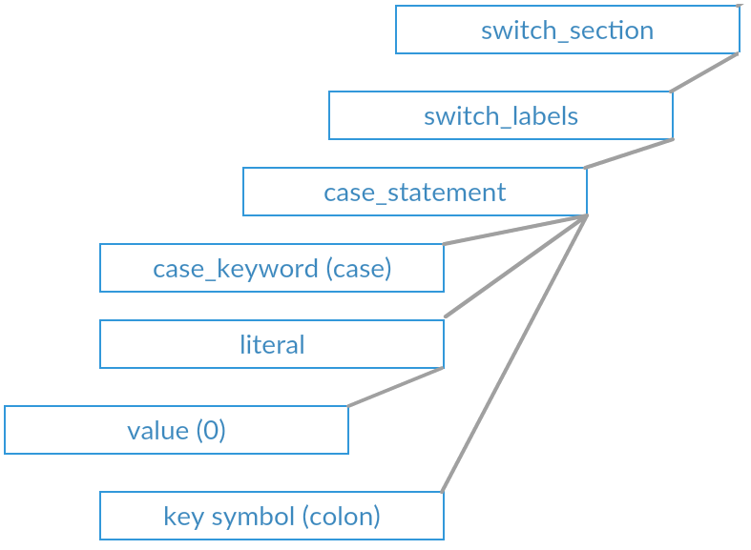
Code Conversion - IRONY
// Code Sample
var test;
switch ( myMember )
{
case 0:
x = test;
break;
}
Frans Kasper, Control Conference 2015

Slide 31
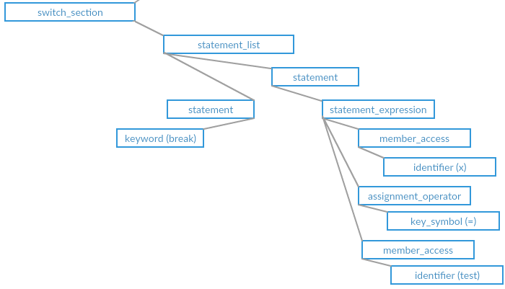
Code Conversion - IRONY
// Code Sample
var test;
switch ( myMember )
{
case 0:
x = test;
break;
}
Frans Kasper, Control Conference 2015

Slide 32
Code Conversion - IRONY
// Code Sample
var test;
switch ( myMember )
{
case 0:
x = test;
break;
}
Frans Kasper, Control Conference 2015

Slide 33
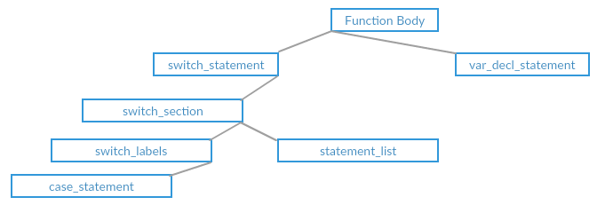
Code Conversion - IRONY
// Code Sample
var test;
switch ( myMember )
{
case 0:
x = test;
break;
}

Slide 34
Code Conversion - IRONY
// IRONY.NET AST Node Example
public class SwitchNode : BlockStatement
{
public override void Init(Irony.Ast.AstContext context, ParseTreeNode treeNode)
{
// basic initialization
base.Init(context, treeNode);
// get all AST nodes inside the switch parentheses.
var nodes = treeNode.GetMappedChildNodes();
// output C++ code to be generated.
CCode = "switch" + "( " + GetCCode(nodes[0]) + ".GetSwitchValue() )";
}
}
Frans Kasper, Control Conference 2015

Slide 35
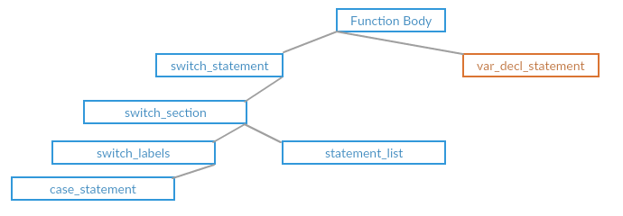
Code Conversion - IRONY
// Code Sample
var test;
switch ( myMember )
{
case 0:
x = test;
break;
}
PGMLVar test;

Slide 36
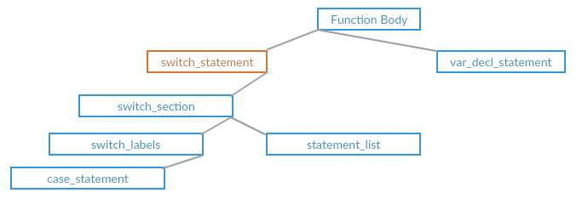
Code Conversion - IRONY
// Code Sample
var test;
switch ( myMember )
{
case 0:
x = test;
break;
}
PGMLVar test;
switch ( _instance->Get( var_myMember ).GetSwitchValue() )

Slide 37
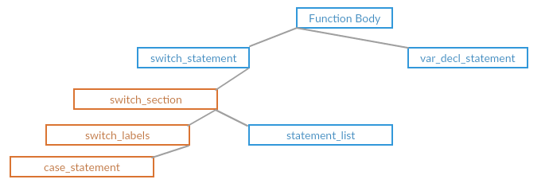
Code Conversion - IRONY
// Code Sample
var test;
switch ( myMember )
{
case 0:
x = test;
break;
}
PGMLVar test;
switch ( _instance->Get( var_myMember ).GetSwitchValue() )
{
case 0:

Slide 38
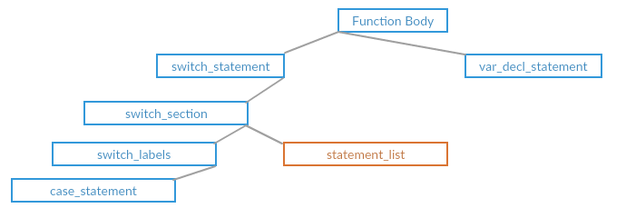
Code Conversion - IRONY
// Code Sample
var test;
switch ( myMember )
{
case 0:
x = test;
break;
}
PGMLVar test;
switch ( _instance->Get( var_myMember ).GetSwitchValue() )
{
case 0:
_instance->GetInstanceVar< var_x >() = test;
break;
}

Slide 39
Code Conversion - IRONY
// Code Sample
var test;
switch ( myMember )
{
case 0:
x = test;
break;
}
PGMLVar test;
switch ( _instance->Get( var_myMember ).GetSwitchValue() )
{
case 0:
_instance->GetInstanceVar< var_x >() = test;
break;
}

Slide 40
Code Conversion - C++
C++ Implementation
GMLVar to emulate variable behavior
Built-in functionality mirrored
Scripts
Execution Flow
Resource Management
Etc.
Compile converted code as usual
Frans Kasper, Control Conference 2015

Slide 41
Code Conversion
Edge Cases & Pitfalls
Non Orthogonal
Complex Variables
‘With’ statement
Frans Kasper, Control Conference 2015

Slide 42
Code Conversion
GML
C++
// scrScriptTest
var test = 0;
switch ( argument0 )
{
case 0:
x = test; // local var
y = myMember; // member var
break;
case "test":
t = global.test; // global var
w = objTest.test; // object var
break;
}
void scrScriptTest( GMLObjectInstance* _instance, GMLObjectInstance* _other, const PGMLVar& argument0 )
{
PGMLVar test = (GMLReal)0;
switch ( argument0.GetSwitchValue() ) // returns hash for string types
{
case 0:
_instance->GetInstanceVar< var_x >() = test;
_instance->GetInstanceVar< var_y >() = _instance->Get( var_myMember );
break;
case 663880771: /* test */
_instance->Get( var_t ) = global.Get( var_test );
_instance->Get( var_w ) = g_objTest.Get( var_test );
break;
}
}
Frans Kasper, Control Conference 2015

Slide 43
Code Conversion
GML
C++
// scrScriptTest
var myVar;
globalvar test;
with ( objTest )
{
x = test;
y = myVar;
}
void scrScriptTest( GMLObjectInstance* _instance, GMLObjectInstance* _other )
{
GMLInstances& instances = g_objTest.GetInstances();
for ( GMLInstances::iterator it = instances.begin(); it != instances.end(); it++ )
{
GMLObjectInstance* current = *it;
if ( current->IsDestroyed() )
continue;
current->GetInstanceVar< var_x >() = global.Get( var_test );
current->GetInstanceVar< var_y >() = myVar;
}
}
Frans Kasper, Control Conference 2015

Slide 44
Code Conversion
C++
C++
template< AgUInt32 VarId > class GMLInstanceVar
{
public:
GMLInstanceVar( PGMLVar& refVar, GMLObjectInstance* instance )
: m_refVar( refVar )
{
switch ( VarId )
{
case var_x:
m_refVar = instance->GetX(); // gets current X position
break;
// etc.
}
}
};
template< AgUInt32 VarId > class GMLInstanceVar
{
public:
void OnChanged()
{
switch ( VarId )
{
case var_x:
instance->SetX( m_refVar ); // also updates bbox
break;
// etc
}
}
};
Frans Kasper, Control Conference 2015

Slide 45
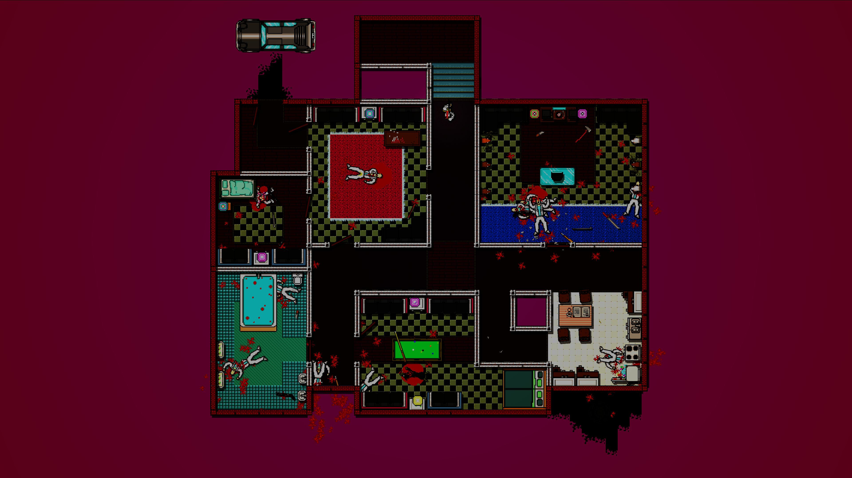
Architecture
Data Conversion
Code Conversion
Architecture
Pros & Cons
Frans Kasper, Control Conference 2015

Slide 46
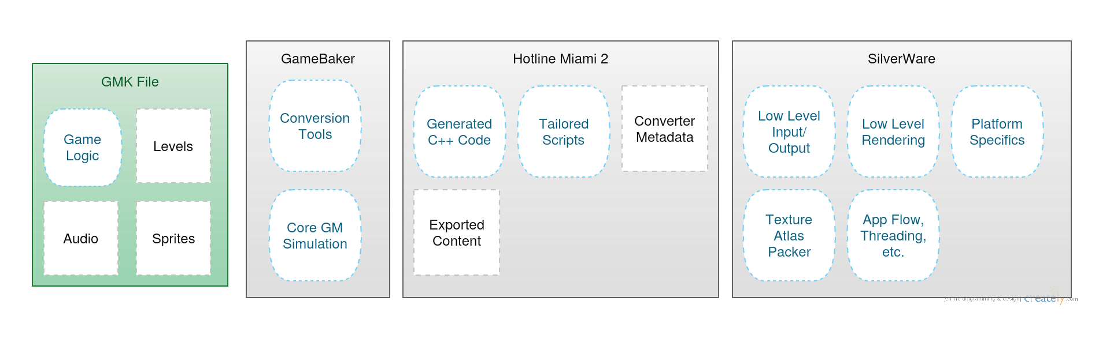
Architecture
Hotline Miami 2
Frans Kasper, Control Conference 2015

Slide 47
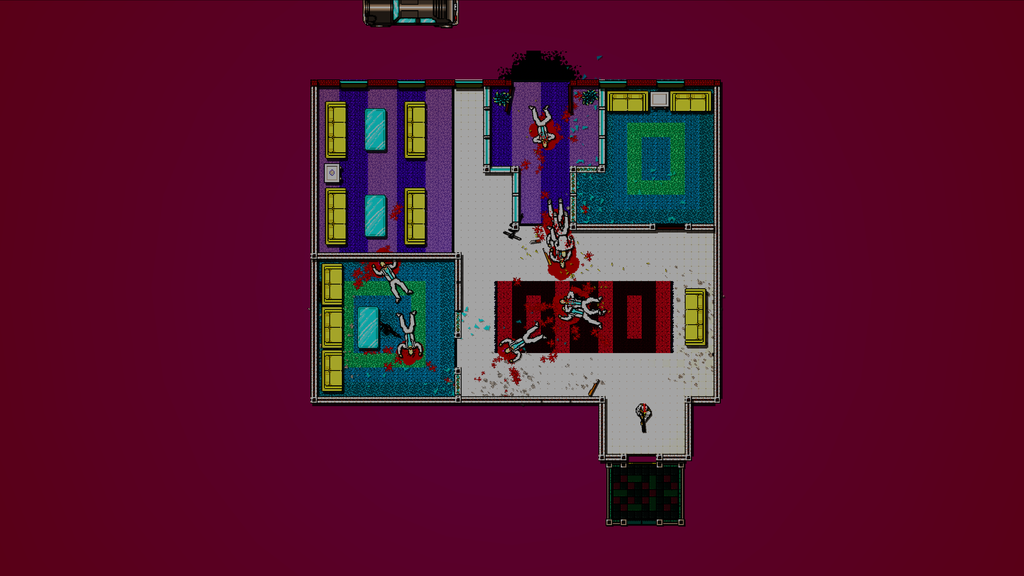
Pros & Cons
Data Conversion
Code Conversion
Architecture
Pros & Cons
Frans Kasper, Control Conference 2015

Slide 48
Pros & Cons
Pros
Full Control, No Dependencies
Better Debugging
Optimization Opportunities
Reusable Technology
Frans Kasper, Control Conference 2015

Slide 49
Pros & Cons
Pros
Full Control, No Dependencies
Better Debugging
Optimization Opportunities
Reusable Technology
Frans Kasper, Control Conference 2015

Slide 50
Pros & Cons
Pros
Full Control, No Dependencies
Better Debugging
Optimization Opportunities
Reusable Technology
Frans Kasper, Control Conference 2015

Slide 51
Pros & Cons
Pros
Full Control, No Dependencies
Better Debugging
Optimization Opportunities
Reusable Technology
Frans Kasper, Control Conference 2015

Slide 52
Pros & Cons
Cons
Time Intensive
Never Complete
Parallel Development Problematic
Complexity
Frans Kasper, Control Conference 2015

Slide 53
Pros & Cons
Cons
Time Intensive
Never Complete
Parallel Development Problematic
Complexity
Frans Kasper, Control Conference 2015

Slide 54
Pros & Cons
Cons
Time Intensive
Never Complete
Parallel Development Problematic
Complexity
Frans Kasper, Control Conference 2015

Slide 55
Pros & Cons
Cons
Time Intensive
Never Complete
Parallel Development Problematic
Complexity
Frans Kasper, Control Conference 2015

Slide 56
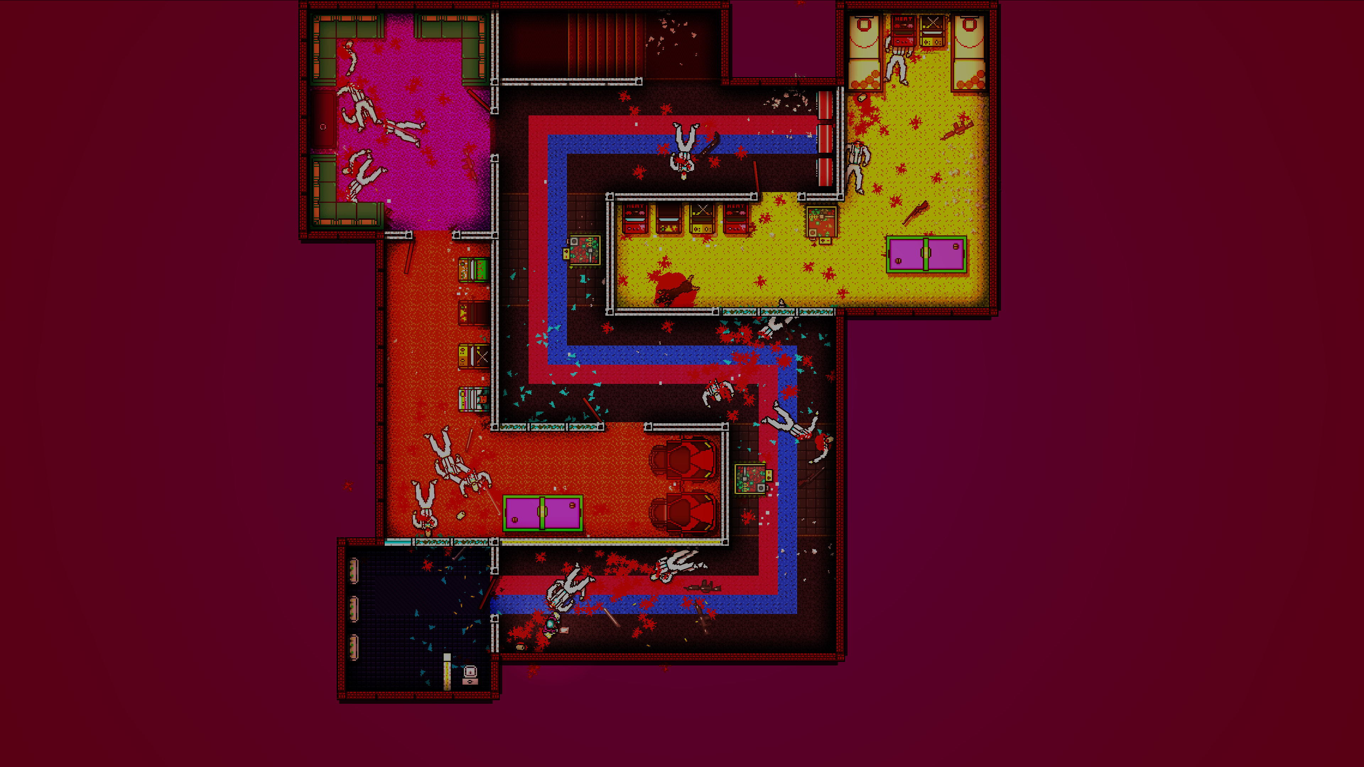
Takeaways
Introduction
Porting at Abstraction Games
SilverWare
Hotline Miami Ports
Frans Kasper, Control Conference 2015

Slide 57
Takeaways
Use the correct tools for the job
Normalize game & engine code
Frans Kasper, Control Conference 2015

Slide 58
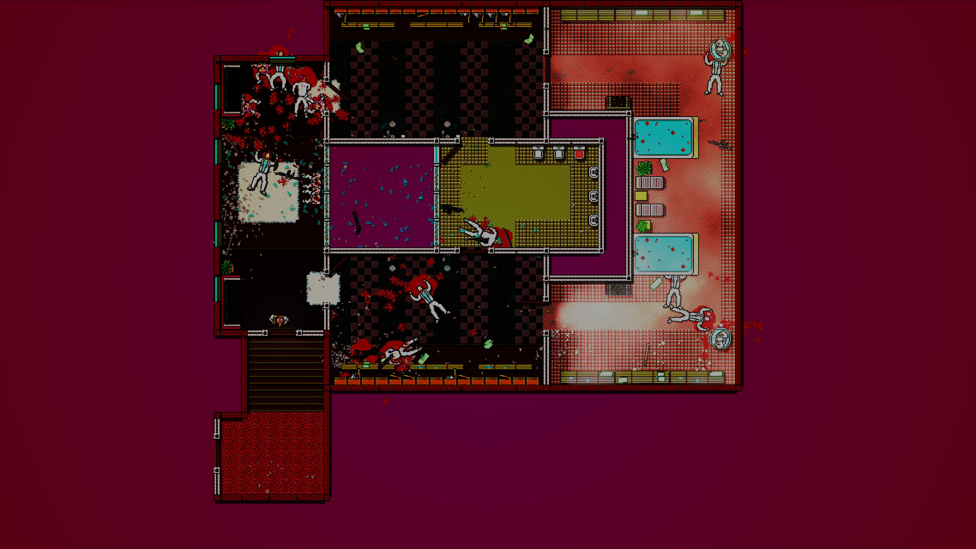


Questions?
http://www.ctrl500.com/tech/
http://www.enigma-dev.org
https://irony.codeplex.com/
http://www.abstractiongames.com
frans.kasper@abstractiongames.com
@snarfk
@AbstractionGame
Frans Kasper, Control Conference 2015

